Slide 1
Factors Influencing Road Accident Severity in the UK: A Data Science Approach
Vivek Morcha
24093946
M.Sc. Data Science Student
University of Hertfordshire
GitHub Repository:
https://github.com/Vivek9049P/alcohol-road-accidents

Slide 2
Introduction
Road accidents are a major public safety issue in the UK
Thousands of accidents occur every year, leading to injuries and fatalities
Understanding accident severity is important for prevention
Data science can help identify patterns and risk factors

Slide 3
Motivation and Research Question
Motivation:
Road accidents lead to serious social and economic impacts
Identifying risk factors can help reduce accidents and save lives
Personal interest in applying data science to real-world problems
Research Question:
What factors most strongly influence road accident severity in the UK?

Slide 4
Previous Work 1
Explainable Machine Learning for Road Accident Severity Prediction (Ahmed et al., 2023)
Used ensemble machine learning models (RF, XGBoost, LightGBM)
Applied explainable AI techniques (SHAP)
Identified key contributing factors to accident severity (road type, alcohol etc.)
Achieved high performance (~81% accuracy)

Slide 5
Previous Work 2
Comparison of Machine Learning Models for Accident Severity Prediction (Rezashoar et al. 2025)
Applied multiple machine learning models to predict accident severity
Used techniques such as Naïve Bayes, SVM, and Neural Networks
Compared model performance to identify the best algorithm
Achieved highest accuracy with Naïve Bayes (~75%)

Slide 6
Comparison with Previous Work
Aspect | Previous Work 1 | Previous Work 2 | This Project
Models Used | Random Forest, XGBoost, LightGBM | Naïve Bayes, SVM, NN | Logistic Regression, Decision Tree, Random Forest
Model Usage | Focus on maximising accuracy | Used mainly for prediction | Prediction + feature analysis
Interpretability | Strong(SHAP) | Limited | Strong (feature importance)
Dataset | Not UK-specific | UK dataset | UK Government STATS19 dataset
Goal | High model performance | Best Model | Understand key factors + real-world insights

Slide 7
DATASET
Dataset Name: UK Road Safety Data (STATS19)
Source: UK Government – Department for Transport
Type of Data: Tabular data (.csv files)
Content Includes:
Accident severity
Driver information (age)
Weather and lighting conditions
Road type and speed limits
Dataset Size: Large-scale dataset covering multiple years (2019-2023)
Collection: Collected by UK police forces and compiled by the Department for Transport
Link: https://www.gov.uk/government/statistical-data-sets/road-safety-open-data

Slide 8
Ethical Implications
No personal identifiable data is used
Data is publicly available and legally accessible
Data is anonymised
Used in accordance with the dataset license
Data will be stored securely

Slide 9
Exploratory Data Analysis (EDA)
Most accidents are slight severity → dataset imbalance
Highest collisions at 30 mph speed limit
Accidents peak during 3–5 PM (rush hours)
Majority occur in clear weather conditions
Urban areas have more accidents than rural
Similar severity patterns across age groups

Slide 10
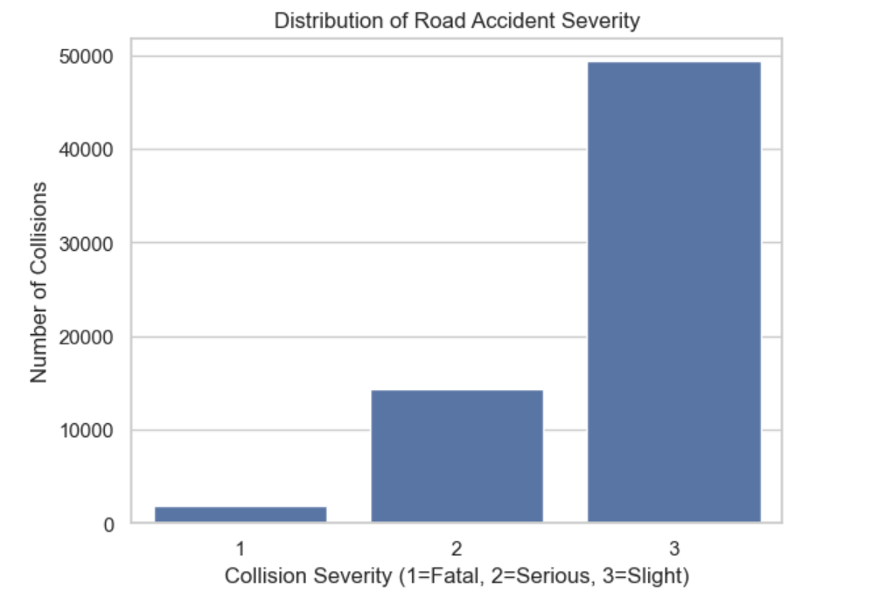
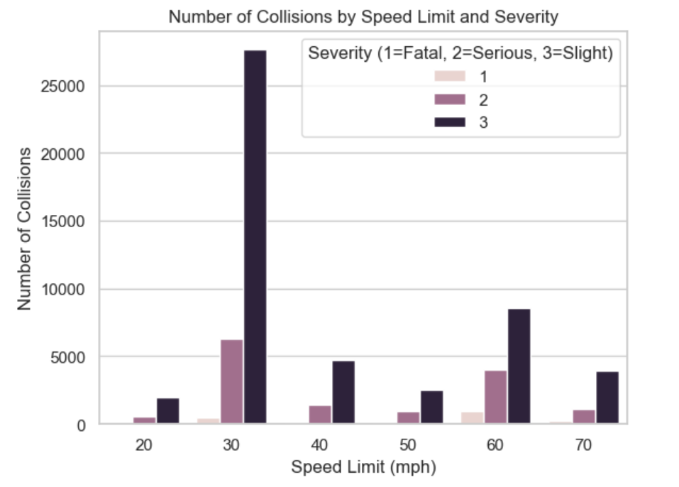
EDA – Severity & Speed Limit
Graph 1: Severity Distribution → Most accidents are slight severity, indicating class imbalance
Graph 2: Speed Limit vs Severity → Highest number of collisions occur at 30 mph speed limit

Slide 11
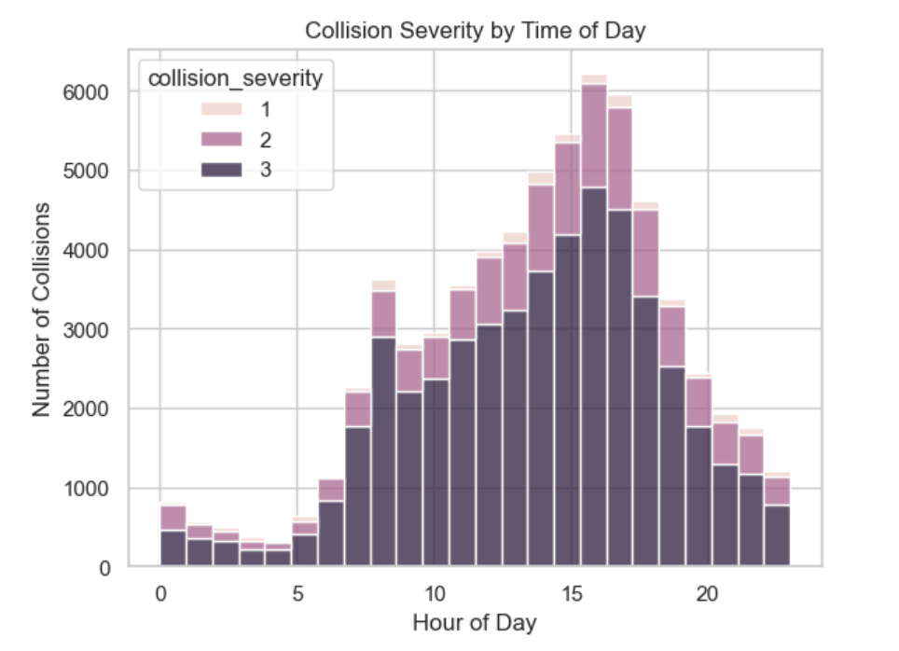
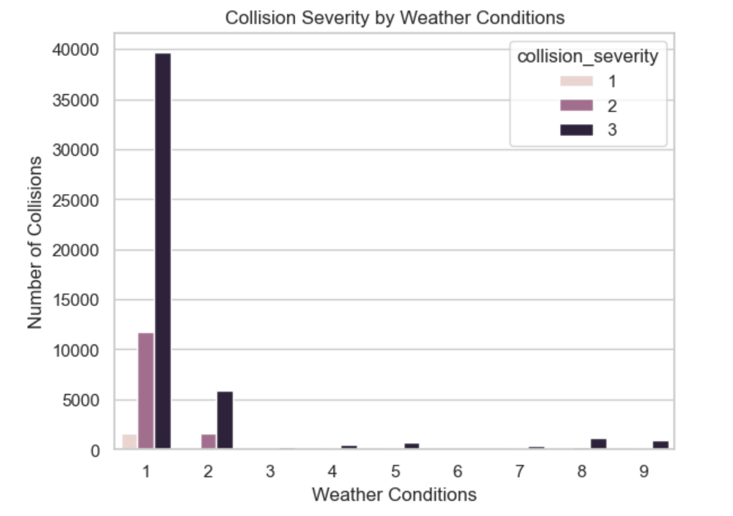
EDA – Time & Weather Analysis
Graph 3: Collision Severity by Time of Day → Accidents peak during 3–5 PM, likely due to rush hour traffic
Graph 4: Collision Severity by Weather Conditions → Most accidents occur in clear weather conditions, suggesting traffic volume is a key factor

Slide 12
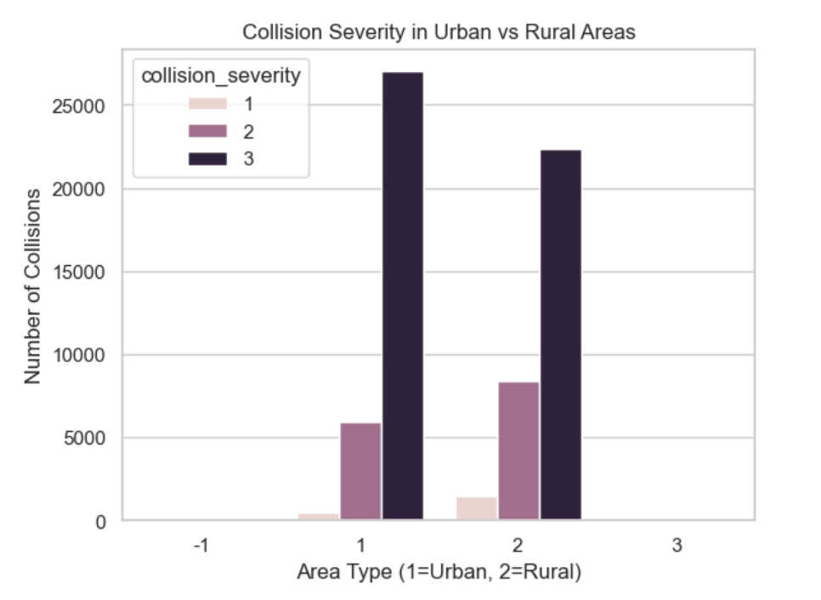
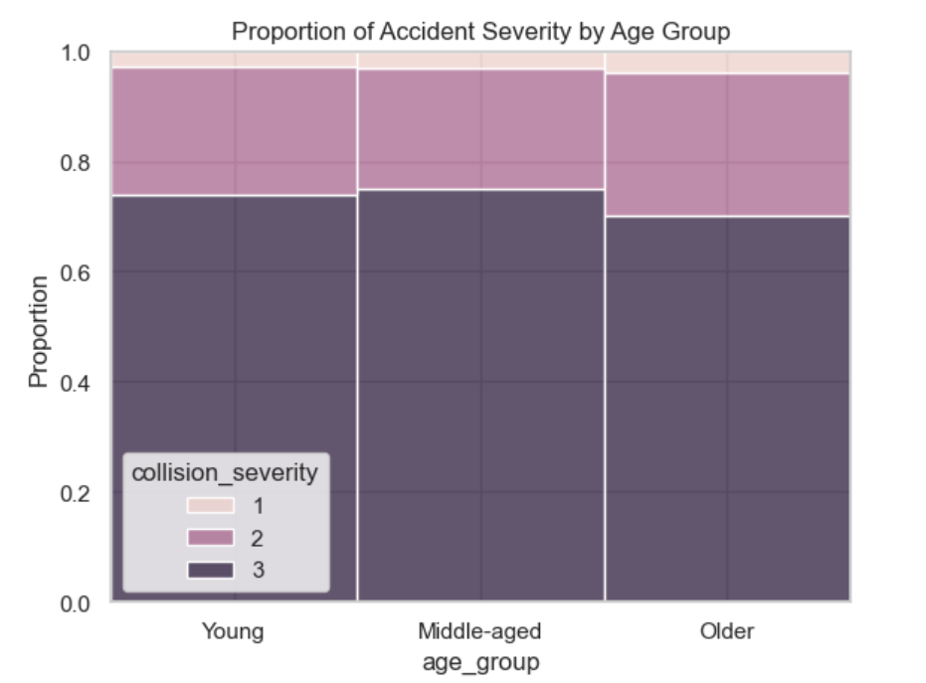
EDA – Area & Age Analysis
Graph 5: Urban vs Rural Accidents → Urban areas have significantly higher accident frequency than rural areas
Graph 6: Severity by Age Group → Similar severity patterns across age groups, with slight accidents most common

Slide 13
Data Pre-processing
Handled missing values (removed or imputed data)
Encoded categorical variables (e.g., weather, road type)
Normalised / scaled numerical features
Performed train-test split (e.g., 80% training, 20% testing)
Addressed class imbalance

Slide 14
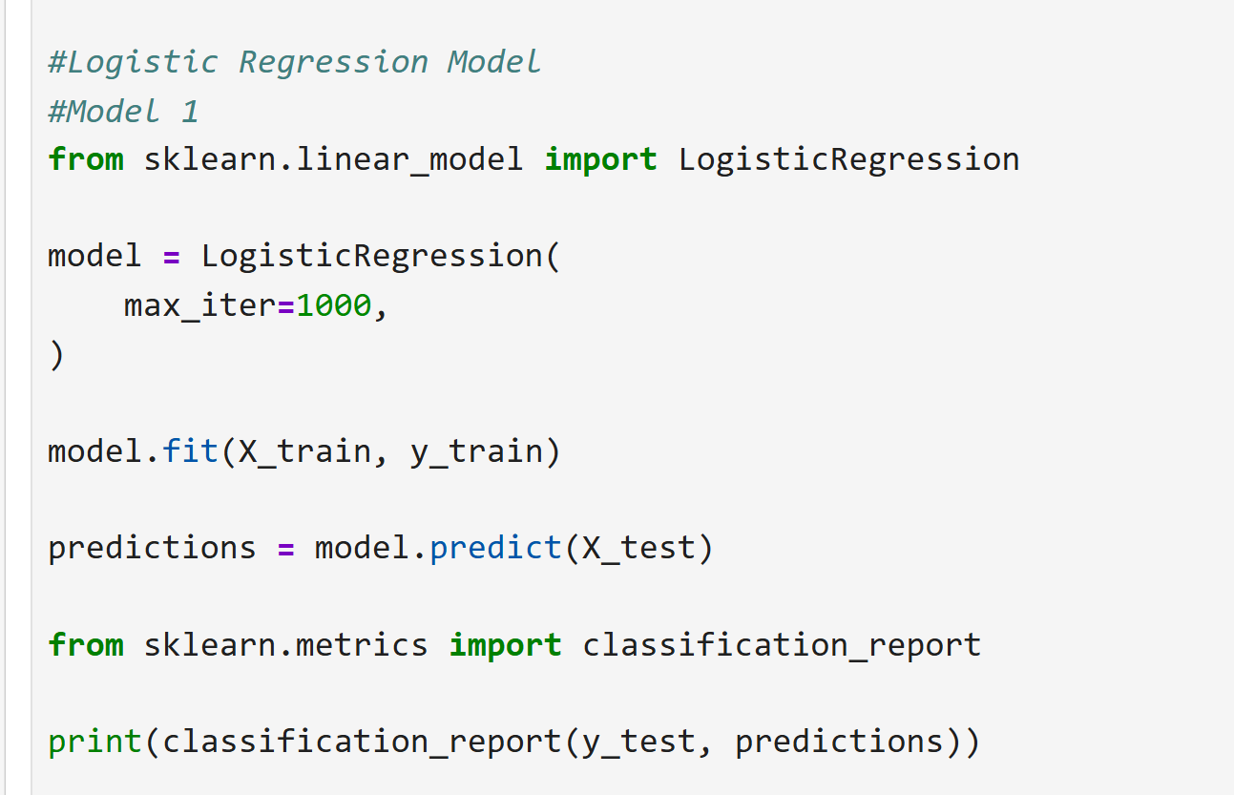
Model Used & Result
Logistic Regression :
Baseline model for performance comparison
Results :
Accuracy: 76%
Performs well for slight severity (Class 0)
Poor performance for serious cases (Class 1)
Indicates class imbalance issue

Slide 15
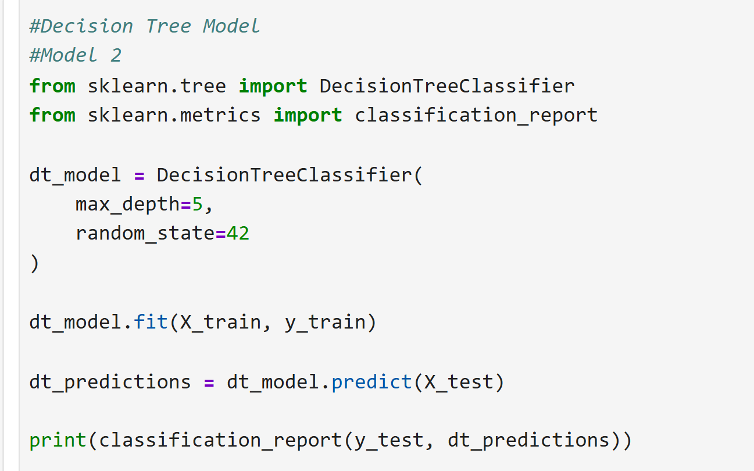
Model Used & Result
Decision Tree :
A model that makes decisions using a set of simple rules
Results :
Accuracy: 76%
High performance for Class 0 (Slight severity)
Very low recall for Class 1 (Serious/Fatal cases)
No significant improvement over Logistic Regression

Slide 16
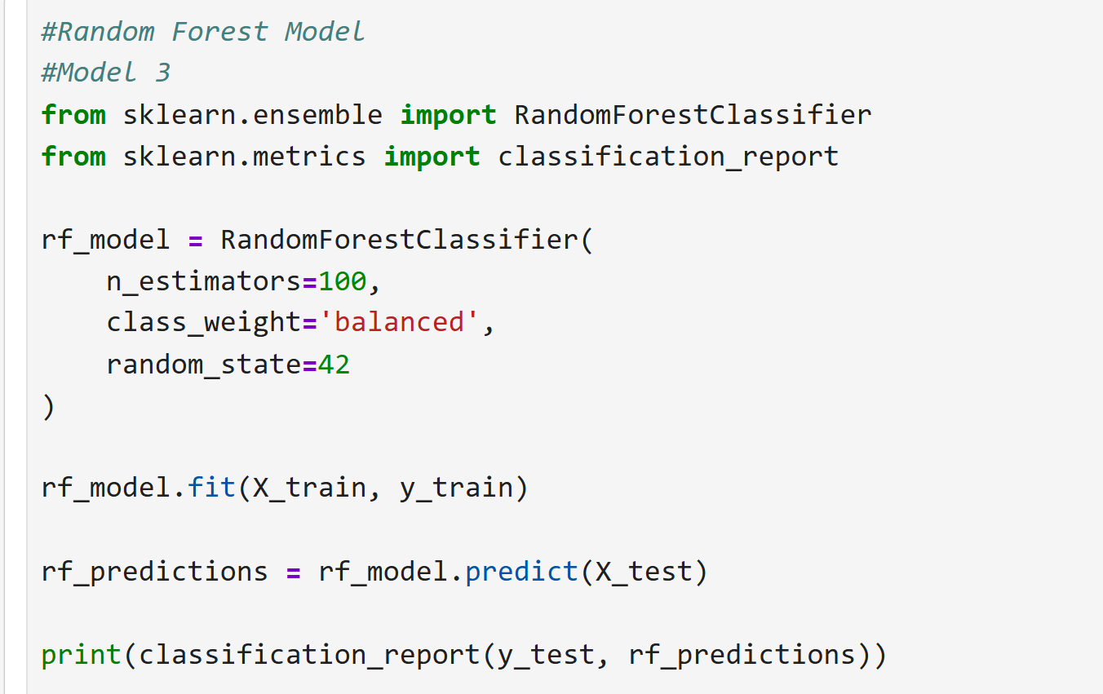
Model Used & Result
Random Forest:
Ensemble model combining multiple decision trees
Results :
Accuracy: 83%
Improved performance compared to previous models
Better recall for Class 1 (Serious/Fatal cases)
More balanced performance across classes

Slide 17
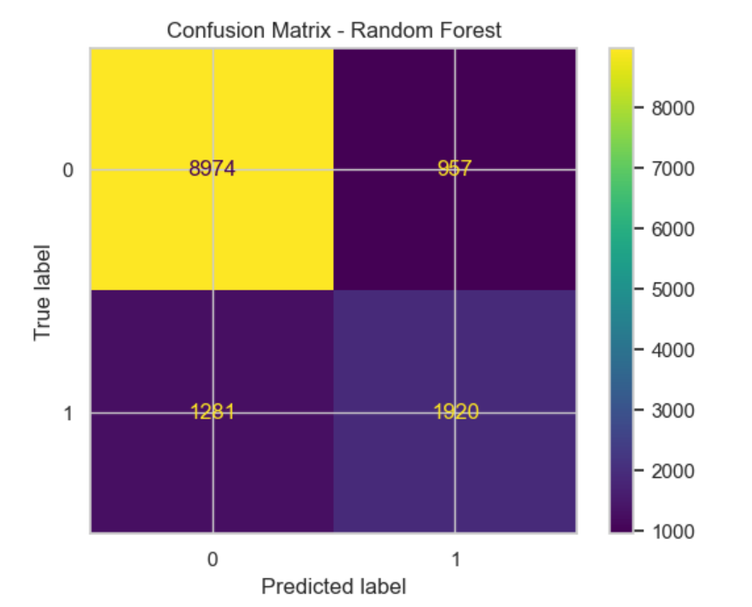
Model Results
Model | Accuracy | Class 1 Recall
Logistic Regression | 76% | 0.02
Decision Tree | 76% | 0.02
Random Forest | 83% | 0.60

Slide 18
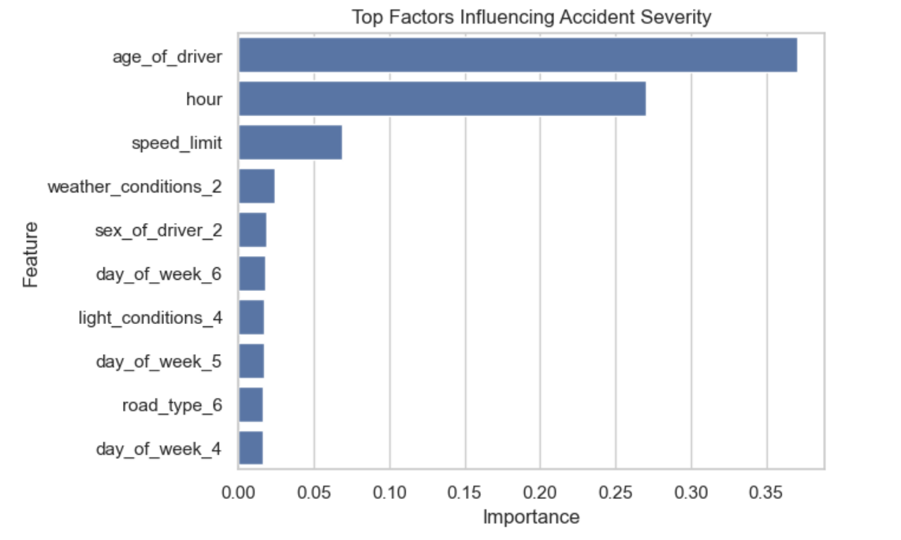
Feature Importance Analysis
Age of driver is the most important factor
Time of day (hour) has a strong influence
Speed limit also contributes significantly
Weather, light conditions, and road type have smaller effects

Slide 19
Analysis
Logistic Regression and Decision Tree showed similar performance
Both models struggled to detect serious accident cases
High accuracy was influenced by class imbalance
Random Forest achieved the best overall performance
Significant improvement in detecting minority class (serious cases)
Provides a better balance between prediction and reliability

Slide 20
Summary & Conclusion
Applied Logistic Regression, Decision Tree, and Random Forest to predict accident severity from road and environmental factors
Got 83% accuracy using Random Forest
Without hyperparameter tuning, Random Forest achieved the best result
Next Steps:
Handle class imbalance
Improve model performance
Prepare for viva and final report

Slide 21
References
Department for Transport (2025), Road Safety Open Data (STATS19) https://www.gov.uk/government/statistical-data-sets/road-safety-open-data
https://www.sciencedirect.com/science/article/pii/S2590198223000611 - Previous Work 1
https://www.tandfonline.com/doi/abs/10.1080/13588265.2025.2507474 - Previous Work 2

